Slide 1
Global Illumination
Collected Images
D. House
11/24/09

Slide 2
Radiosity

Slide 3
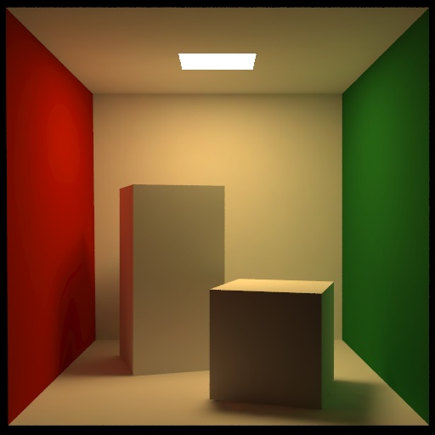
The Cornell Box

Slide 4


Where: B_{i} is the radiosity of patch I, E_{i} is emitted energy, R_{i} is the reflectivity of the patch.
All j (j != i) in the rendered environment are integrated for B_{j}F_{ji} dA_{j}, to determine the energy leaving each patch j that arrives at patch i.
F_{ij} is the constant-valued view factor for the radiation leaving i and hitting patch j.
The reciprocity:
For ease of use the integral is replaced and uniform radiosity is assumed over the patch:

Slide 5

Radiosity for Architectural Rendering

Slide 6
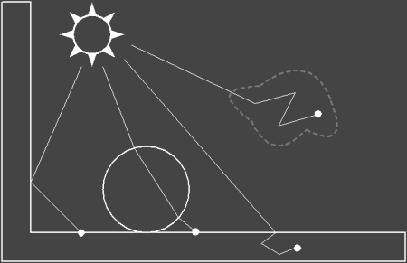
Photon Mapping

Slide 7
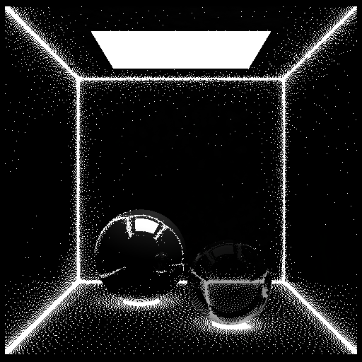

Slide 8
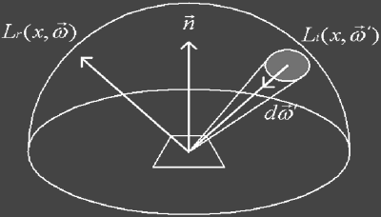

Slide 9
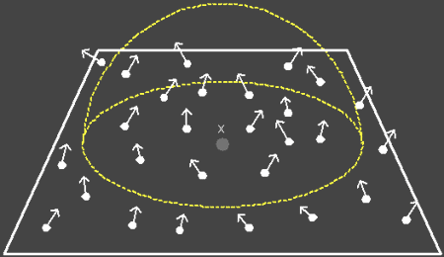

Slide 10
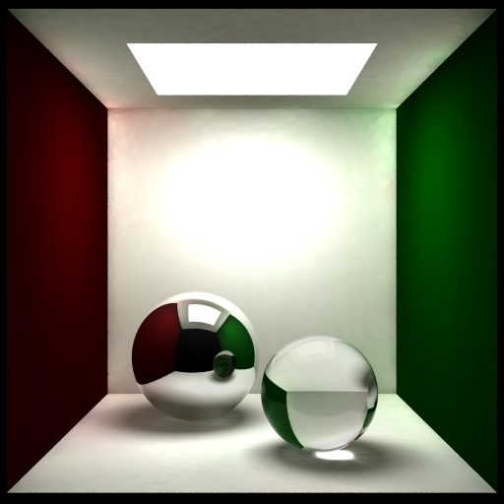

Slide 11
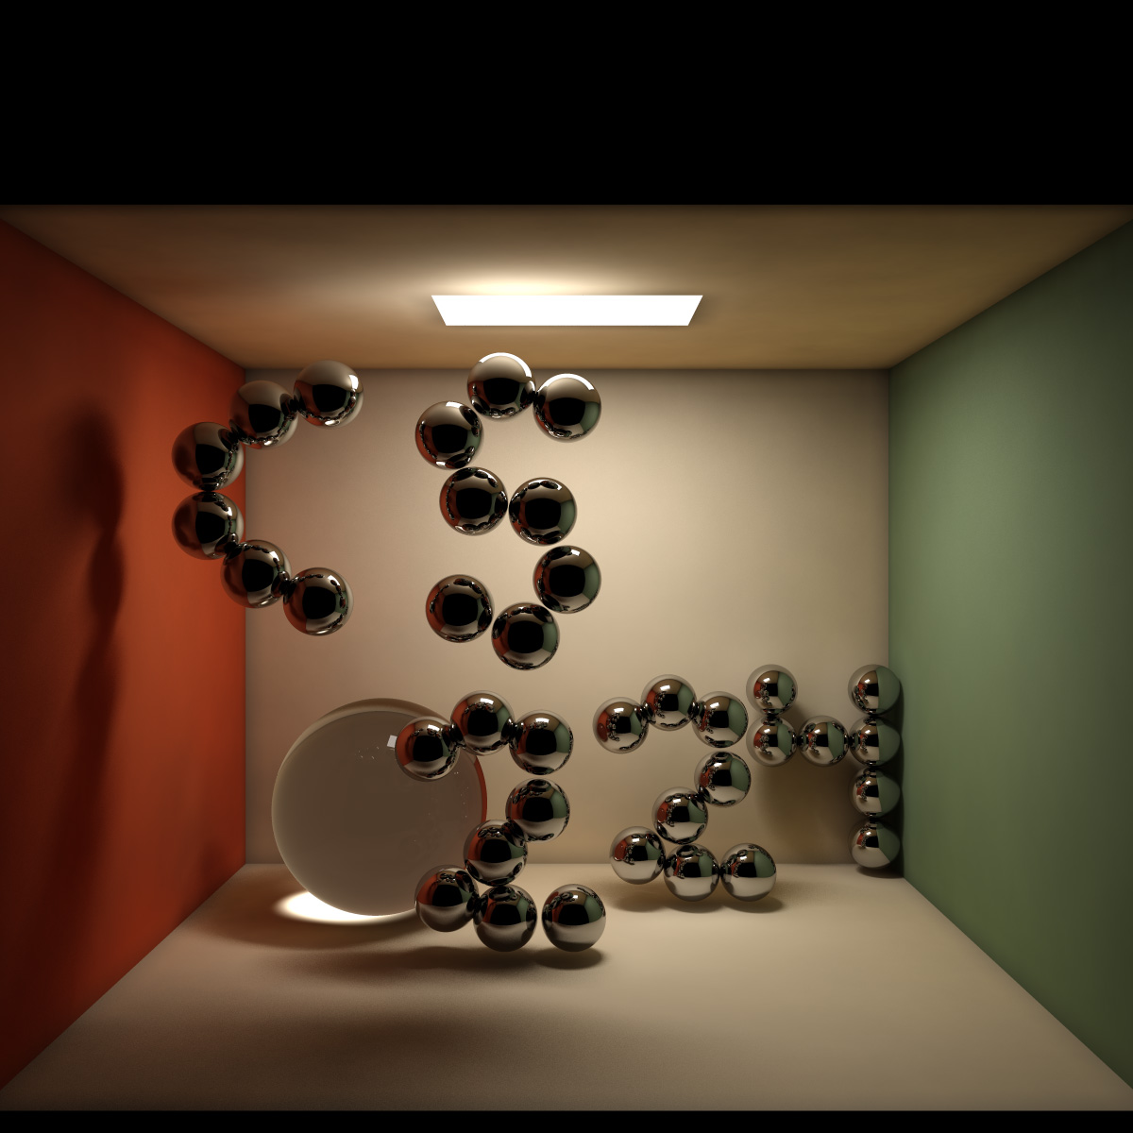
Cornell Box with refractions and reflections

Slide 12
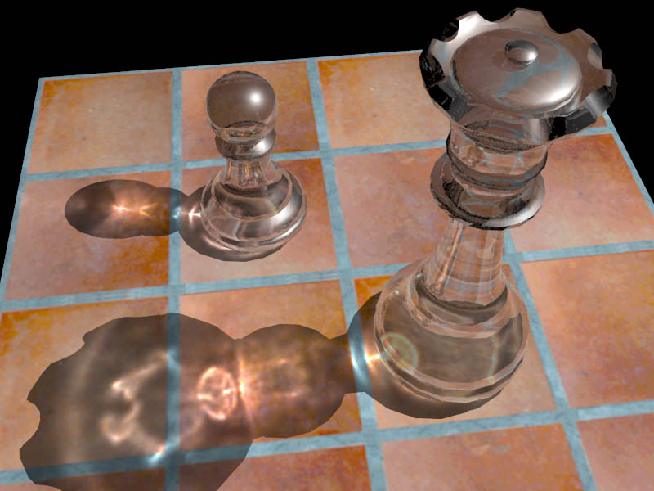
Caustics

Slide 13

Subsurface Scattering

